Slide 1

META-OPTIMIZATION
Optimizer Hyperparameters via Bayesian Optimization
Directed by :
El Boussanni Assia
Alasely Rofaydae
Bach Rokia
Framed by :
Pr Benabbou Faouzia
Mme Ellaky Zineb

Slide 2

Contents
1
Introduction
2
Objectives
3
Methodology
4
Results
5
Conclusion

Slide 3

Introduction
Forecasting time series is a major challenge in many fields, such as meteorology or finance. LSTM models are particularly effective for this type of data, but their performance is highly dependent on the choice of optimizer and its hyperparameters. This work explores the use of Bayesian optimization to automatically adjust the parameters of the SGD, Adam and RMSprop optimizers, in order to improve prediction accuracy.

Slide 4

Problem
How to automatically optimize the hyperparameters of optimization algorithms (such as Adam, SGD, RMSprop) in order to improve the performance, stability and efficiency of time series forecasting models (such as LSTM or Transformer), using intelligent search methods such as Bayesian Optimization or Hyperband?

Slide 5

Objectives
Improve the performance of LSTM models for weather forecasting.
Automatically optimize hyperparameters in SGD, Adam and RMSprop optimizers.
Use Bayesian optimization for efficient tuning.
Compare results in terms of accuracy, training speed and stability.

Slide 6


Early Hyperparameter Tuning Methods
Tests all combinations of hyperparameters
❌ Becomes impractical in high-dimensional spaces
✅ Simple and exhaustive
Grid Search
Samples hyperparameters randomly
✅ Often finds good results faster
❌ Still inefficient in complex spaces
Random Search

Slide 7

Bayesian Optimization (BO)
for Hyperparameter Tuning
To improve model performance, Bayesian Optimization (BO) was used to automatically tune the hyperparameters of the Adam, SGD, and RMSprop optimizers. Unlike manual tuning, BO uses a smart search strategy that builds a model of the optimizer’s performance and selects new hyperparameters based on where improvement is most likely. This allowed the model to converge faster and with better accuracy.

Slide 8
Dataset ||
Column description
Column Name | Description
T (degC) | Temperature in degrees Celsius
p (mbar) | Atmospheric pressure in millibars
rh (%) | Relative humidity as a percentage
wv (m/s) | Wind velocity in meters per second
year | Year extracted from the datetime column
hour_sin | Sine transformation of the hour (used to represent cyclical time features)
hour_cos | Cosine transformation of the hour (used to represent cyclical time features)
month_sin | Sine transformation of the month (used to represent cyclical month info)
month_cos | Cosine transformation of the month (used to represent cyclical month info)

Slide 9
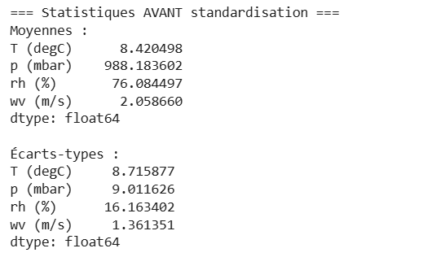


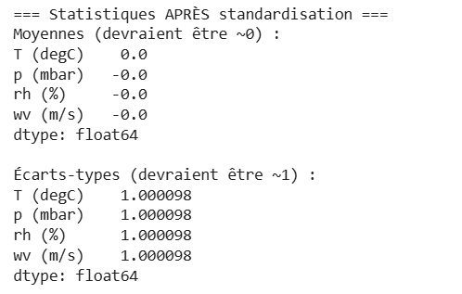
Dataset || Feature Standardization
To ensure optimal performance of the LSTM model, selected numerical features are standardized using the StandardScaler, which transforms the data to have zero mean and unit variance. This standardization process helps stabilize the model's learning process and ensures that each feature contributes equally, preventing any single feature from disproportionately influencing the model due to scale differences.

Slide 10




Dataset Splitting || Training and Testing Sets
The training set is used to fit the LSTM model, allowing it to learn temporal patterns in the data.
The testing set remains untouched during training and is later used to assess the model's generalization ability and predictive accuracy on new, real-world data.
Training
Testing
80%
20%

Slide 11

Model Type: Sequential Stacked LSTM
Number of LSTM Layers: 2 Hidden
Units: 64 (first layer), 32 (second layer)
Output Layer: Dense (1 neuron for single-step prediction)
Loss Function: Mean Absolute Error (MAE)
Model architecture
LSTM (Long Short-Term Memory) is a type of neural network designed to process sequential data, such as time series. It differs from conventional recurrent networks in its ability to store information over long periods. Thanks to a system of gates (enter, forget, exit), the LSTM decides which information to retain or forget, making it particularly well-suited to tasks such as weather forecasting or sequence modeling.

Slide 12

Optimizers and Hyperparameters
RMSprop
Adaptive like Adam, useful for noisy data.
Hyperparameters:
learning_rate
rho: decay rate for mean squared gradients
SGD
Simple, efficient optimizer, based on updating weights with each sample.
Hyperparameters:
learning_rate: learning rate
momentum: inertia to accelerate convergence
nesterov: momentum improvement (Boolean)
Adam
Combines the advantages of SGD with momentum and RMSprop.
Hyperparameters:
learning_rate
beta1: moment factor for moving averages
beta2: for gradient variance

Slide 13

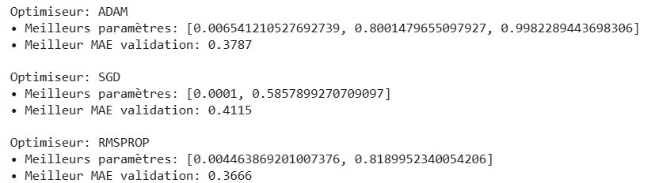
Hyperparameter Tuning with Bayesian Optimization
✔ Efficient search: Finds optimal hyperparameters with fewer evaluations vs. grid/random search.
✔ Balances exploration/exploitation: Uses Expected Improvement (EI) to focus on promising regions.
Implementation Details :
Library: scikit-optimize (skopt).
Acquisition Function : Expected Improvement (default)
Initial Random Points: 10 (default of gp_minimize)
Optimization Trials : 20 evaluations per optimizer
Objective: Minimize val_mae during training with early stopping
Results

Slide 14

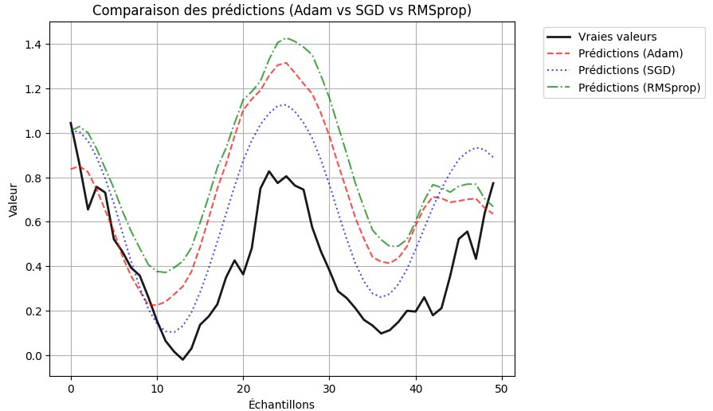
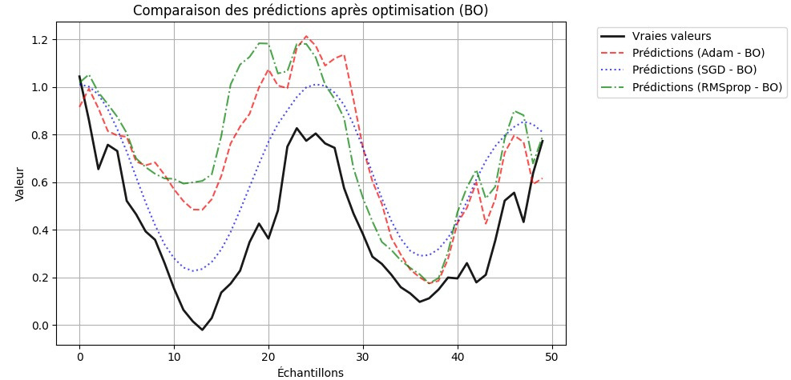
RESULTS & ANALYSIS

Slide 15

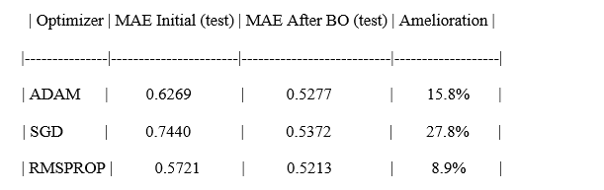
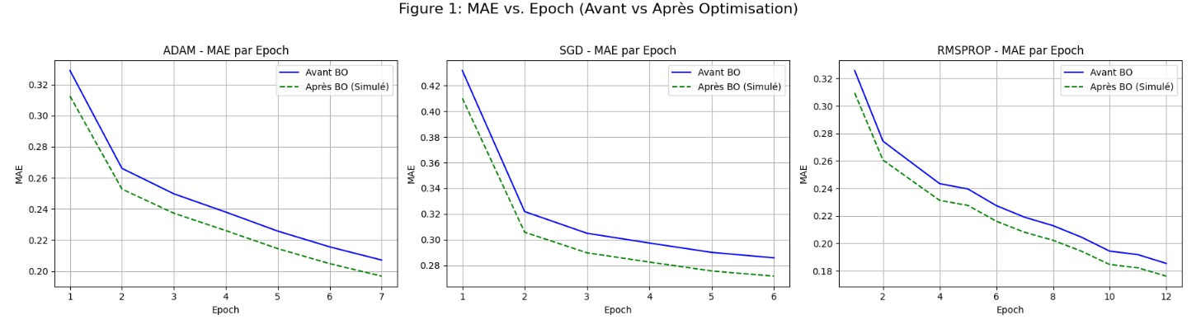
mae Comparaison before and after optimization

Slide 16

Conclusion
The results show that Bayesian optimization can significantly improve the performance of LSTM models by effectively adjusting the hyperparameters of the optimizers. Of the three methods tested, SGD combined with BO delivered the best results in terms of accuracy and stability. This approach confirms the value of meta-optimization techniques for enhancing the efficiency of deep learning models in forecasting tasks.

Slide 17

THANKS
FOR YOUR attention !

